Slide 1

Auto-Generating Efficient Data-Plane ML Pipelines
Muhammad Shahbaz
Kevin C. and Suzanne L. Kahn New Frontiers Assistant Professor
Purdue University

Slide 2
A network should provide …
Connectivity
Deterministic, and impacts functionality
Performance
Non-deterministic, doesn’t impact functionality
Security
Machine Learning
Notes:
A network should provide connectivity between the participating hosts, while sustaining high performance and preserving privacy of the participating applications (or jobs).
(click) Connectivity is deterministic, i.e., if not done properly can affect the functionality of the system (or environment).
(click) Performance/security, on the other hand, are non-deterministic … they won’t affect functionality, but can slowdown the system.
If asked today, I’d argue that we will use machine learning to implement the performance and security aspects of networking.
So, why are we not doing it, what’s stopping us … well many things.

Slide 3
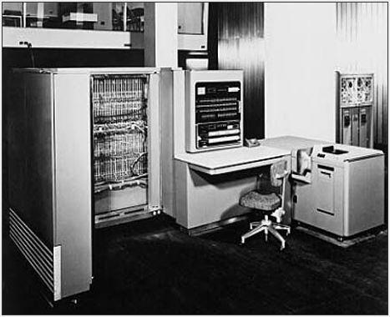
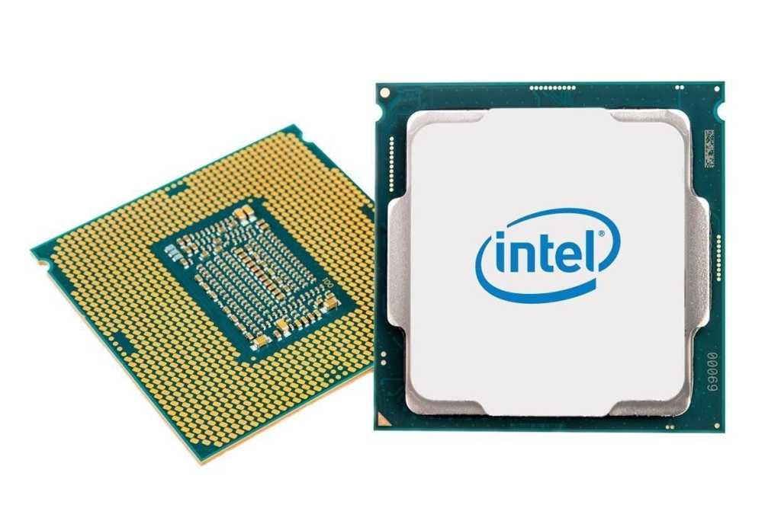
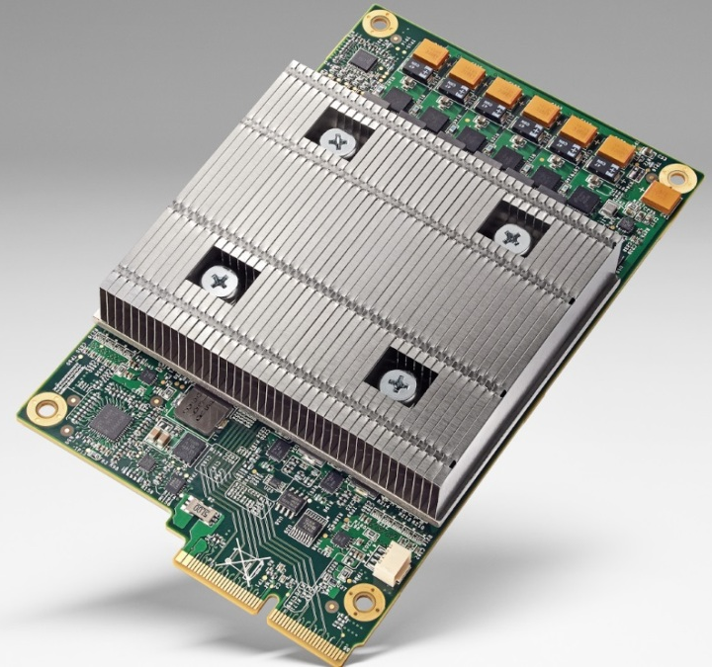
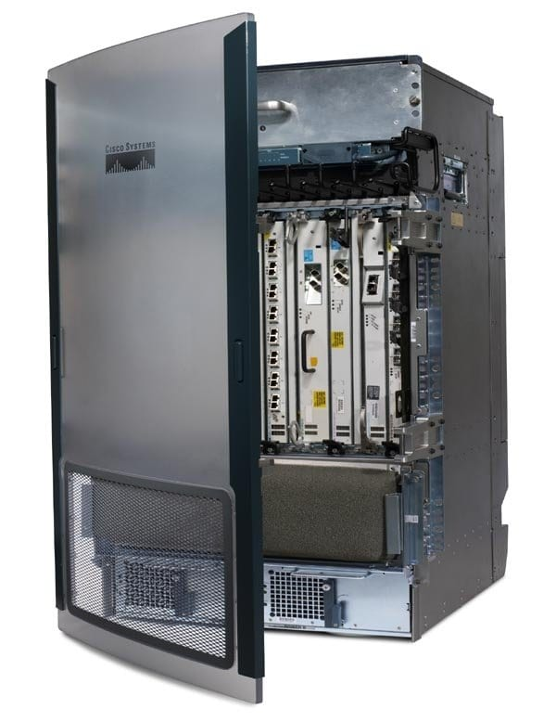
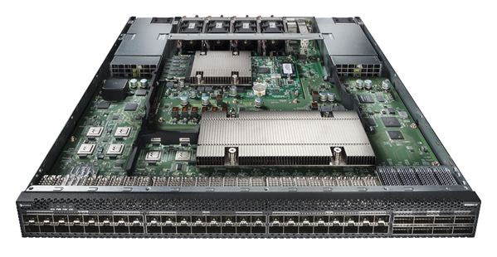
History of Systems vs. Networking
Fixed-function
Processors
Programmable
Processors
Domain-Specific
Processors
1930s
1970s
2010s
Fixed-function
Switches
Programmable
Switches
Networking is running 40 years behind of Systems
Notes:
The first fixed-function processor came about in the 30s … there were handful of applications at the time so making a dedicated machine for them made sense.
(click) However, in the 70s the first programmable CPU was introduced to enable feature velocity. The focus here was on flexibility. (A Turing complete machine.)
(click) But, more recently, we have seen the emergence of DSA to support use cases like ML to attain high performance.
(click) In the networking, we got our first fixed-function switches in the 70s. These were the early days; networks were small and we knew what protocols to run on them.
(click) Then programmable switches came about in the 2010s to allow more flexible operations …
however, these switches are slow to support performance and security use cases and have a lot common with the CPUs of the 70s … that made these CPUs a poor fit for modern use cases.

Slide 4

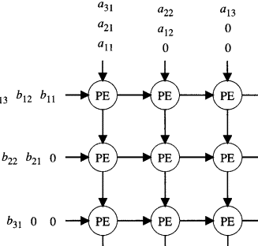
Programmable Processors vs Switches
ML
ML
ML
ML
for i = 1 to m
for j = 1 to n
…
A collection of Match-Action (MAT) Rules
MAC Systolic Array
???
OS
NOS
???
CPU
TPU
Prog. Switch
(Tofino)
???

Slide 5

Taurus: A Data-Plane ML Switch
ASPLOS ‘22, IETF/ANRP Prize, IEEE Micro Top Picks (Honorable Mention)
Spatial
https://spatial-lang.org

Slide 6
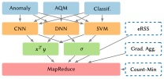
Taurus: A Data-Plane ML Switch

Slide 7
Taurus: A Data-Plane ML Switch
Taurus examines every packet at line rate
Added latency is less than port-to-port latency
Area
Power
Model
Throughput
Latency
+%
+%
SVM
1 GPkt/s
68 ns
6.1
1.1
DNN
1 GPkt/s
362 ns
11.7
2.0
*Overheads are calculated relative to a 300 mm² chip with 4 reconfigurable pipelines, each drawing an estimated 25 W

Slide 8
Programmable Processors vs Switches
ML
ML
MAC Systolic Array
???
???
TPU
???

Slide 9
Programmable Processors vs Switches
PyTorch or TensorFlow
???
ML
ML
MapReduce
Abstraction
MAC Systolic Array
Taurus
TPU
ML Switch

Slide 10

Homunculus: A Data-Plane ML Framework
ASPLOS ‘23, Best Artifact Award

Slide 11
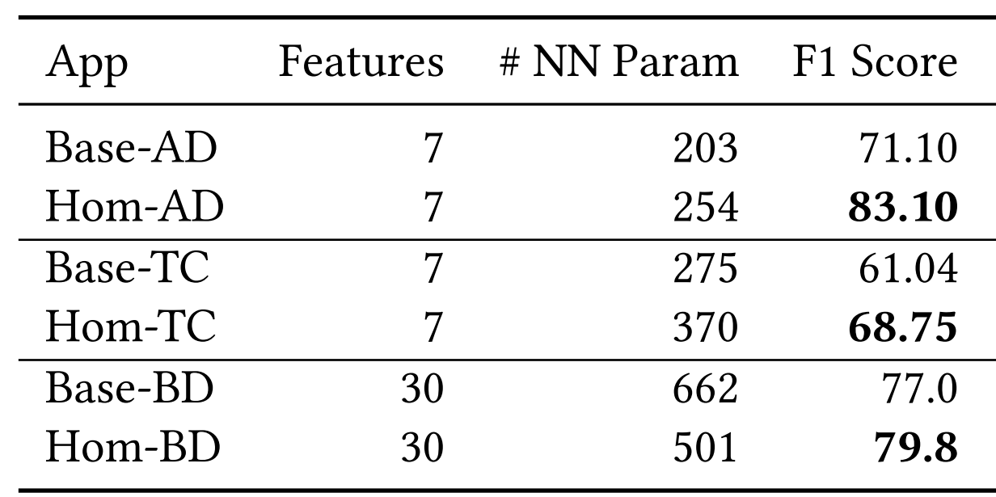
Homunculus: A Data-Plane ML Framework
F1 Score improvements in anomaly detection (AD), traffic classification (TC), botnet detection (BD)
+16.9%
+12.6%
+3.6%

Slide 12
Programmable Processors vs Switches
PyTorch or TensorFlow
???
ML
ML
MapReduce
Abstraction
MAC Systolic Array
Taurus
TPU
ML Switch

Slide 13
Programmable Processors vs Switches
PyTorch or TensorFlow
Homunculus
ML
ML
MapReduce
Abstraction
MAC Systolic Array
Taurus
TPU
ML Switch

Slide 14
Open Research Challenges
Homunculus
Feature engineering
Data collection
Auto labeling
Model design
Operator Interfaces
And more …
ML
Co-Design of
ML
+
Network
+
Architecture
MapReduce
Abstraction
Scaling to larger models
- via Chiplets
Handling sparsity
Model training
Newer switch abstractions
Flow-points ops
And more …
Taurus
ML Switch

Slide 15

Questions?
Follow Us
  PurNET Lab - https://purnet-lab.gitlab.io
  NextGArch Lab - https://mshahbaz.gitlab.io
Co-Design of
ML
+
Network
+
Architecture

